Slide 1
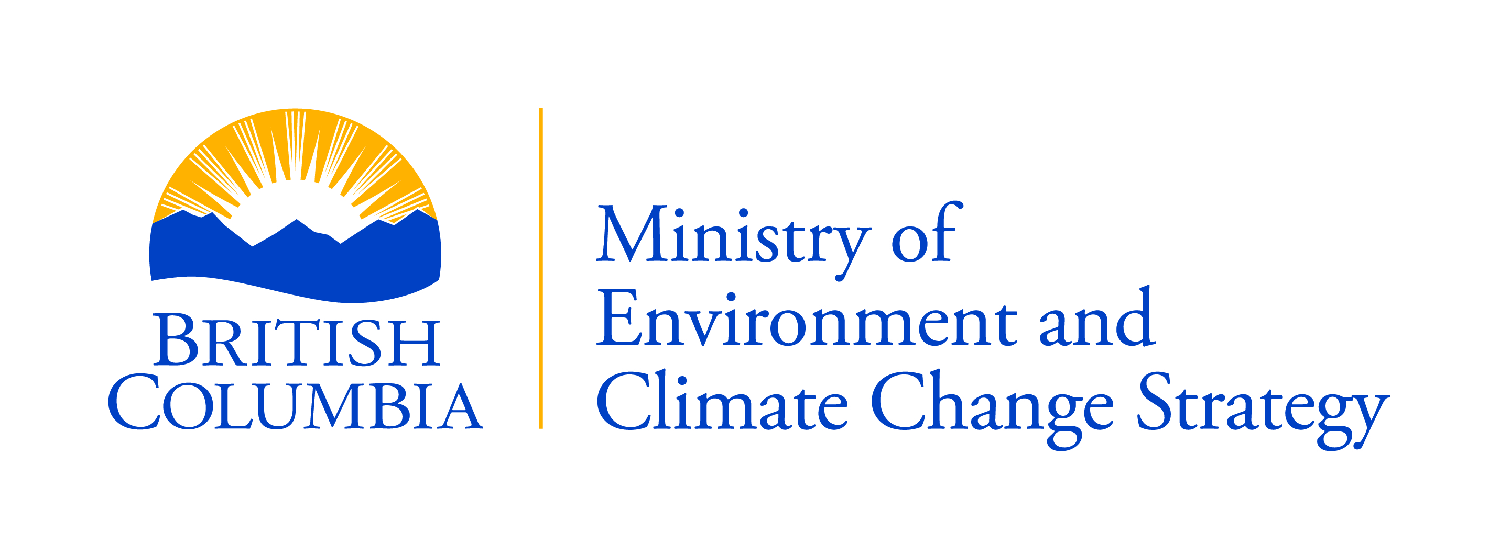
Reviewing the Professional Reliance Model in the Natural Resource Sector (NRS)
Notes:
Hello, I’m here to give you an overview of the initiative to review professional reliance in the NRS that is being led by the Ministry of Environment and Climate Change Strategy.
I’ll start by giving you a little context about how this initiative began.
When the NDP came into power they signed the Confidence and Supply Agreement with the Green Caucus that lays out how both parties will work together.
One priority in that agreement was to review professional reliance in the NRS.
As a result, this became one of our ministries mandate commitments.
Although the model as we know it today came into being around 2002-2003, and it was created for good reason and with good intentions, no one has conducted a full review of it to see whether it is working and what aspects need improving.
So it makes a lot of sense that we take a step back to see where we can make improvements.

Slide 2
Project Objectives
Whether professional associations that oversee qualified professionals (QPs) employ best practices to protect the public interest;
Whether government oversight of professional associations is adequate; and
Conditions governing the involvement of QPs in government’s resource management decisions and the appropriate level of government oversight to assure the public their interests are protected.
Notes:
Don’t pay too much attention to the words here, they’ve been word smithed to the point where they don’t actually make sense.
This initiative is about 3 things:
Are self governing professional associations overseeing qualified professionals appropriately to ensure the public interest is protected?
Is government oversight of self governing professional associations appropriate?
Across the suite of regulatory decisions and processes in the sector, are the appropriate checks and balances in place and are decisions held in the right place to protect the public interest
Now I’ve used the term “protect the public interest” several times in the last couple minutes. That’s because this initiative is all about ensuring this model of structuring work in the sector is doing what is intended, that is allow NR decisions to be made faster, give industry more flexibility, but also ensuring the public interest is protected

Slide 3
Project Components
Compliance Audit of Professional Associations
Appropriateness & Effectiveness Assessment
Public Engagement
Jurisdictional Scan
Report with Recommendations
Notes:
This review consists of five components
Read components…

Slide 4
1. Professional Association Compliance Audit
Associations in scope
BC Institute of Agrologists
College of Applied Biology
Engineers and Geoscientists of BC
Association of BC Forest Professionals
Applied Science Technologists & Technicians of BC
Progress:
Audit reports for each association being developed
Reports complete by February 28, 2018
Notes:
The first component is focussed on the first two objectives of this project: are self regulating professional associations ensuring the public interest is protected as they fulfill their legislated mandate to govern qualified professionals, and is governments oversight of these associations appropriate?
Here are the five professional associations that are in scope for this review
Read off associations…
We’re looking to see whether these associations are following the statutory requirements of their self governing legislation.
Not only are they following the letter of the law but also whether they’re following the spirit of the law.
We have conducted day long interviews of these associations as well as received significant documentation from them all.
Based on this information we are developing a report for each association that summarizes their responses and assesses their compliance with each of their statutes.
These reports will complete by the end of this week.

Slide 5
2. Appropriateness & Effectiveness Assessment
Are there decisions being made by QPs that should be held within government?
Are there effective checks & balances to protect the public interest?
Progress:
Interviews w/ SME’s & SDM’s currently underway for 36 regulatory regimes
Regime assessments to be complete by February 28, 2018
Notes:
The second component of this review is to conduct an assessment of every regulatory regime within the sector where QPs are relied upon to answer two main questions.
In situations where decisions have been delegated outside of government, is this an appropriate delegation or should, for various reasons these decisions be brought back within government. For instance, some decisions have significant impact on the landscape and involve a variety of competing values and it would be inappropriate to ask a QP to make judgements on values that are outside of their professional expertise.
Are the appropriate checks and balances in place in these different regulatory regimes to protect the public interest. A good example of this is the contaminated sites regime. In this system there is a roster of professionals approved to do specific work, government delegates only low and medium risk decisions to the approved professionals, and a portion of their work is independently reviewed to ensure standards are being met. So we’re looking across the sector to see whether checks and balances are in place relative to risks, and whether the public interest is in fact being protected.
Our team is conducting assessment of 36 NR regulatory regimes. We’re nearing the end interviews with subject matter experts and SDMs and we will have assessments of each of these regimes shortly.

Slide 6
3. Public Engagement
Progress:
Public engagement closed
2,400+ public surveys completed
1,800+ QP surveys completed
100+ formal stakeholder submissions
270+ citizen submissions
Summary report due February 28, 2018
20+ stakeholder interviews completed (will continue)
All indigenous nations invited to be interviewed & review recommendations before public release
Notes:
We also conducted what I consider extensive engagement on this initiative.
Engagement was open from mid December until the end of January.
As you can see from the response numbers there was a lot of interest in this initiative.
We are developing a report to summarize the results of our public & QP surveys, stakeholder and citizen submissions which will be complete by the end of this week as well.
In addition, we have conducted several dozen interviews with stakeholders and will continue to do so until this initiative is complete.
Finally, we have invited every indigenous nation in the province to be interviewed by our team to share their experience and perspectives on how professional reliance may or may not be working in their traditional territory.
We have also given each nation the opportunity to review our final recommendations before they are released publicly.

Slide 7
4. Jurisdictional Scan
Progress:
Contractor looking at other jurisdictions & sectors for different approaches to professional reliance
Report due February 28, 2018
Notes:
The fourth component of this review is a jurisdictional and sectoral scan of how professional reliance is done elsewhere with learnings that could be applied to the BC context.
We currently have a contractor conducting this work and will have the final report by the end of this week.

Slide 8
5. Report
Final report will await results of audits, interviews, working group analyses, public input and jurisdictional scan
To be delivered Spring 2018
Notes:
Finally, the results of all the other components of this review will be taken as inputs to the creation of a final report with recommendations on improving professional reliance in the sector.
This report will be complete by this spring and will be submitted to the Minister of Environment and Climate Change Strategy.
So that wraps up my update on this initiative, I’m happy to answer any questions you may have.

